Slide 1

Conditional Statements in Python

Slide 2
Introduction
Python if Statement is used for decision-making operations.
It contains a body of code which runs only when the condition given in the if statement is true.
If the condition is false, then the optional else statement runs which contains some code for the else condition.
Python language provide the following conditional (Decision making) statements.
if statement
if...else statement
if...elif...else statement
Nested if..else statement

Slide 3
Indentation
Python uses indentation to express the block structure of a program. Unlike other languages, Python does not use braces, or other begin/end delimiters, around blocks of statements; indentation is the only way to denote such blocks.
Each logical line in a Python program is indented by the whitespace on its left. A block is a contiguous sequence of logical lines, all indented by the same amount; a logical line with less indentation ends the block.
All statements in a block must have the same indentation, as must all clauses in a compound statement.
The first statement in a source file must have no indentation (i.e., must not begin with any whitespace).
Statements that you type at the interactive interpreter primary prompt >>> (covered in Interactive Sessions) must also have no indentation.

Slide 4
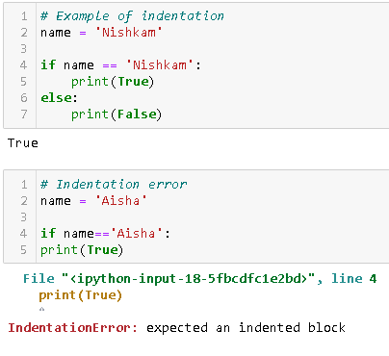
Examples -
Print statement starting from next line without space.

Slide 5
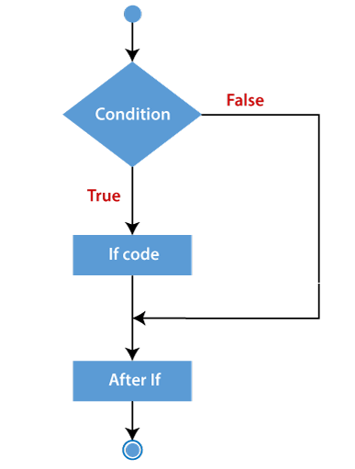
If statement
The if statement is a decision making statement. It is used to control the flow of execution of the statements and also used to test logically whether the condition is true or false.
Python if Statement Syntax:
If condition:
statement

Slide 6
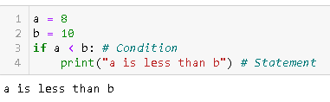
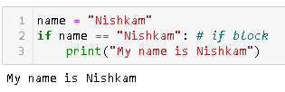
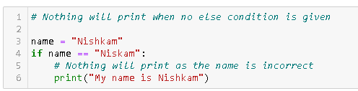
Examples -

Slide 7
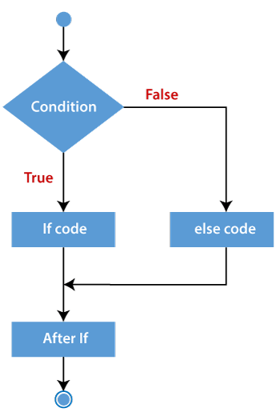
If … else statement
The if…else statement is called alternative execution, in which there are two possibilities and the condition determines which one gets executed.
The "else condition" is usually used when you have to judge one statement on the basis of other. If one condition goes wrong, then there should be another condition that should justify the statement or logic.
Python if else Statement Syntax:
If condition:
statement
else:
statement

Slide 8
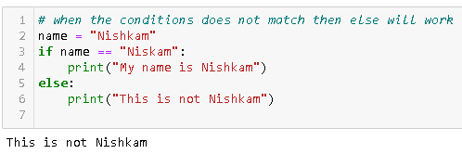
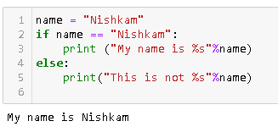
Examples -

Slide 9
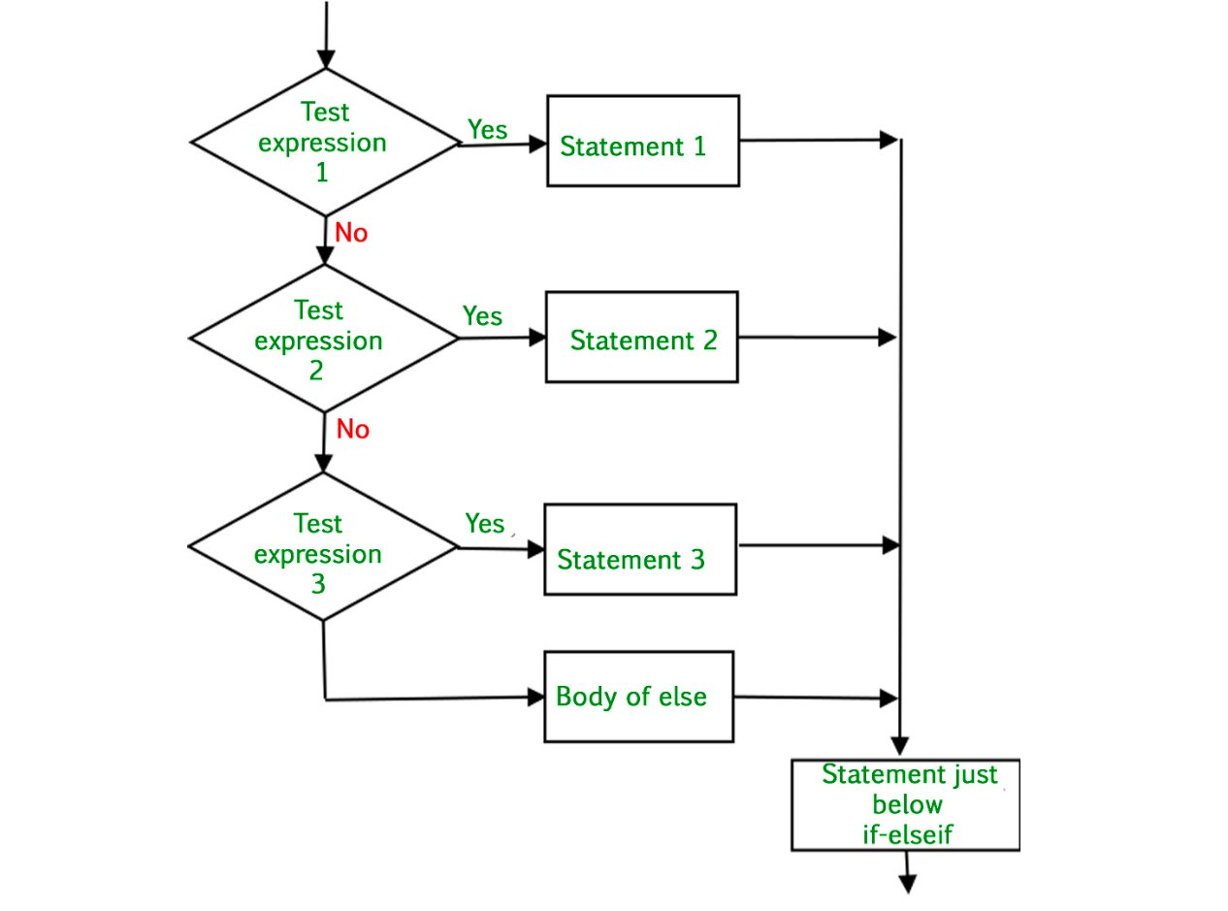
If..elif..else Statements
elif – is a keyword used in Python in replacement of else if to place another condition in the program. This is called chained conditional.
Chained conditions allows than two possibilities and need more than two branches.
Python if.. elif… else Statement Syntax:
If condition1:
statement1
elif condition2:
statement2
else:
statement3

Slide 10
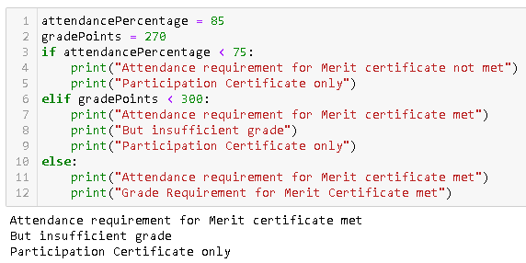
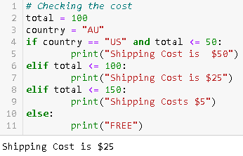
Examples -

Slide 11
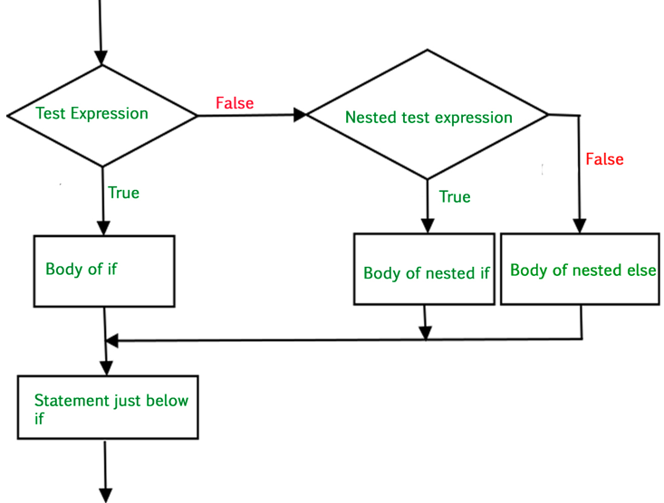
Nested if … else Statements
We can write an entire if… else statement in another if… else statement called nesting, and the statement is called nested if.
In a nested if construct, you can have an if … elif … else construct inside an if … elif.. Else construct.
Python nested if.. elif… else Statement Syntax:
if expression1:
statement(s)
if expression2: statement(s)
elif expression3:
statement(s)
else:
statement(s)

Slide 12
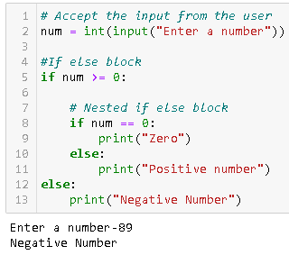
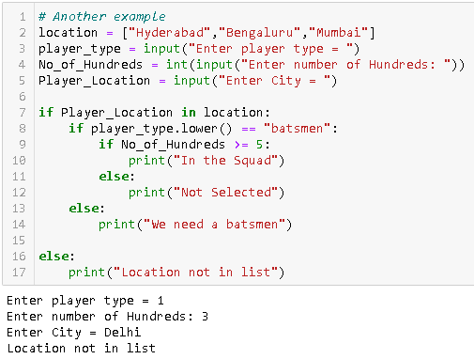
Examples -

Slide 13
Summary
A conditional statement in Python is handled by if statements and we saw various other ways we can use conditional statements like Python if else over here.
"if condition" – It is used when you need to print out the result when one of the conditions is true or false.
"else condition"- it is used when you want to print out the statement when your one condition fails to meet the requirement
"elif condition" – It is used when you have third possibility as the outcome. You can use multiple elif conditions to check for 4th,5th,6th possibilities in your code
We can use minimal code to execute conditional statements by declaring all condition in single statement to run the code
Python If Statement can be nested

